Slide 1
ITAPP Final Presentation
Group 3
By: Jayden,Sean,Oviyaa,Vivion

Slide 2
Table Of Contents
Introduction
2. Business Needs
3. Solution
4. Results

Slide 3
What is our purpose?
We are part of Shopee’s UX/UE design team
To provide a better user experience and service to online customers
To address customers needs and concerns and satisfy their desires
To retain existing customers and get others to use our services

Slide 4
Business Needs
(Smart Shopping)
Users are not able to differentiate between dupes
Once users sees a good deal they make rash and poor decisions
Shopee doesn't have a feature to teach new users to shop smartly

Slide 5
Business Needs
(Overwhelming options)
There is an overwhelming number of similar items
It is hard to navigate through the website
Very time consuming for users to compare similar products
Can cause decision fatigue making customers annoyed

Slide 6
Business Needs
(Lack of Personalisation)
Cannot find top picks of specific products in different categories
Unable to gather user preferences to offer tailored recommendation
Struggle with options due to vast range of options

Slide 7
Business Needs
(Lack of immersive UX/UE)
Lack of in-store experience
being able to try on products
Unable to physically test items/products to see results before buying
Users regret their purchase leading to bad reviews and refunds

Slide 8
Solutions For Smart Shopping
(Interactive Game Simulator)
A mini game to improve decision making and user engagement
Simplify shopping process to encourage users to buy from them
Provides tips on how to shop smartly based on users answers

Slide 9
Solutions For Overwhelming Options
(Virtual Shopping Assistant)
Give you recommendations based on your answers in the quiz
Recommends you products that go well with what you have bought
Enhances user experience and easy navigation through the website

Slide 10
Solutions For Lack Of Personalisation
(Personalised Shopping Quiz)
Deliver relevant product suggestions based on customer preferences
Provide instant recommendations based on answers
Create a interactive experience to promote repeat visits

Slide 11
Solutions Lack of Immersive UE/UX
(Virtual Try-On Simulator)
A simulator that allows users to try on different makeup products with different shades and formulas
It shows a before and after effects of using the product
A small zoom in feature when product is clicked to ensure the users know which product is simulated

Slide 12
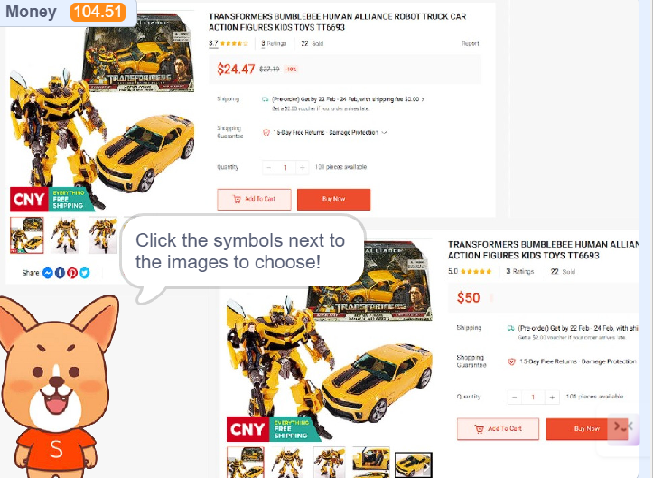
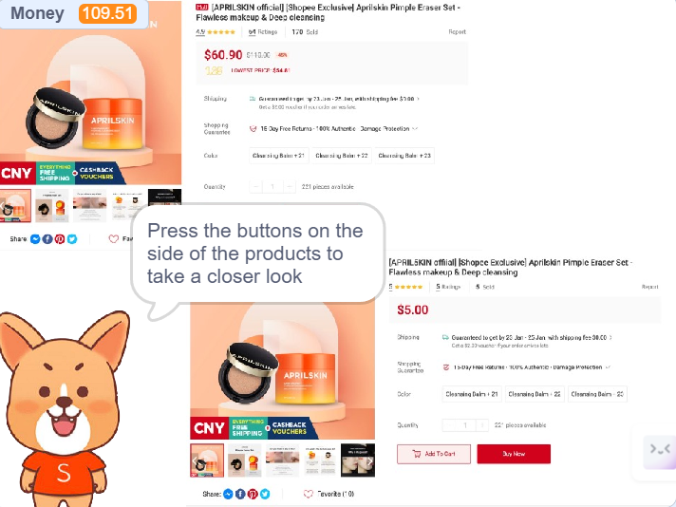
Results
((Interactive Game Simulator)
Key Features:
Provide tips on how to shop smartly and not get scammed
Gives you a certain amount of money to learn how to manage spending
Compare different types of products based on reviews and price

Slide 13
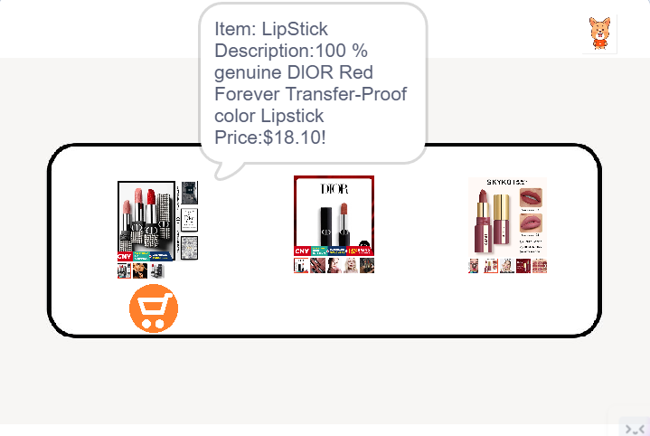
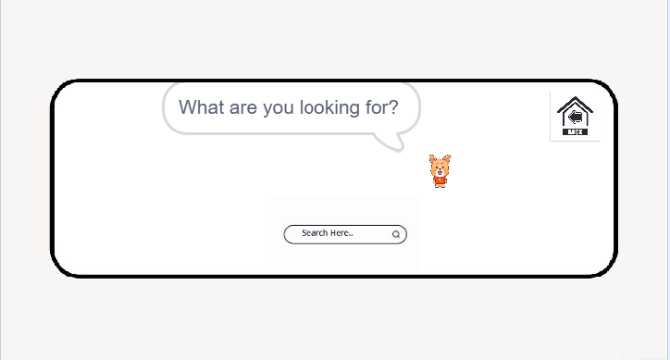
Results
(Virtual Shopping Assistant)
Key Features:
Minimises overwhelming options
Filter out specific items based on user answers in the quiz
Recommend items that will go well with what users have purchased

Slide 14
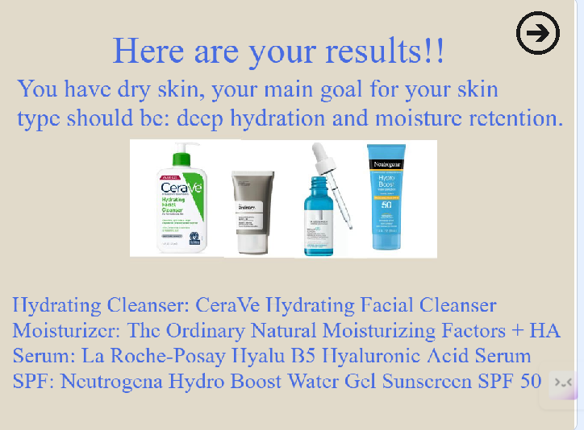
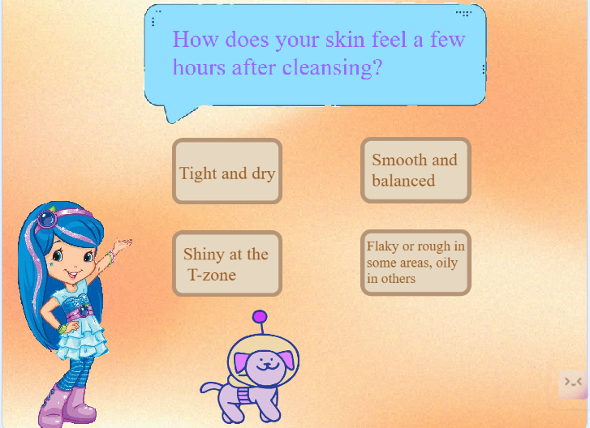
Results
(Personalised Shopping Quiz)
Key Features
Able to collect data on users preferences
Give specific recommendations based on users answer to question
Enhances interactive user experience

Slide 15
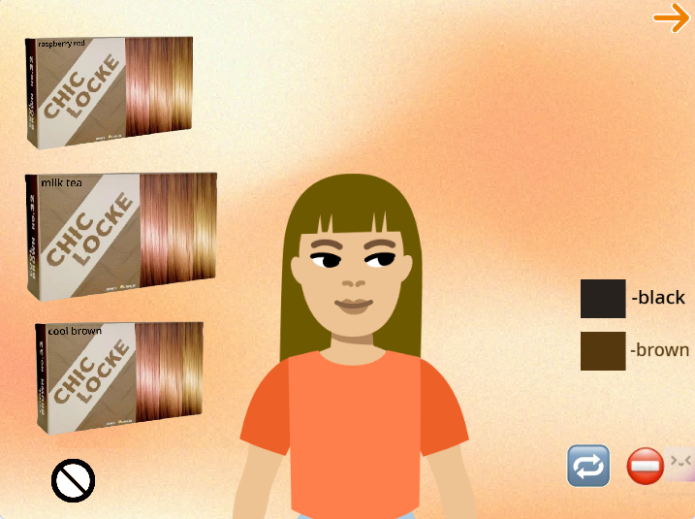
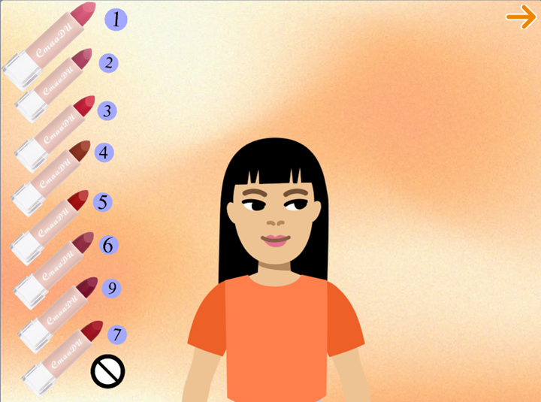
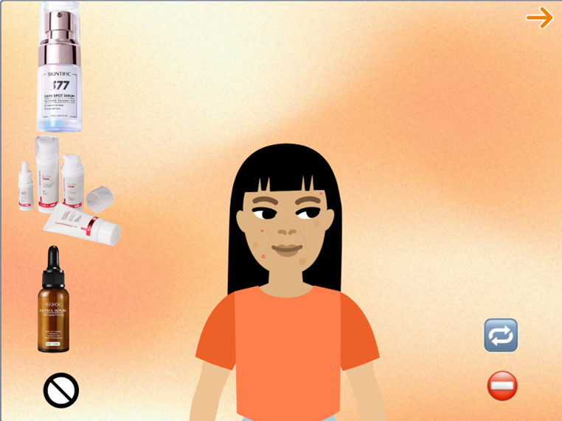
Results
(Virtual Try-On Simulator)
Key Features
Able to test out different types and colours of makeup products
Shows the after effect of how the product will look like on users
Enhances immersive users experience

Slide 16
Demo Time

Slide 17
Thank you for listening :)
PLS GIVE A

